Slide 1
Capstone Project
Coursera Project

Slide 2
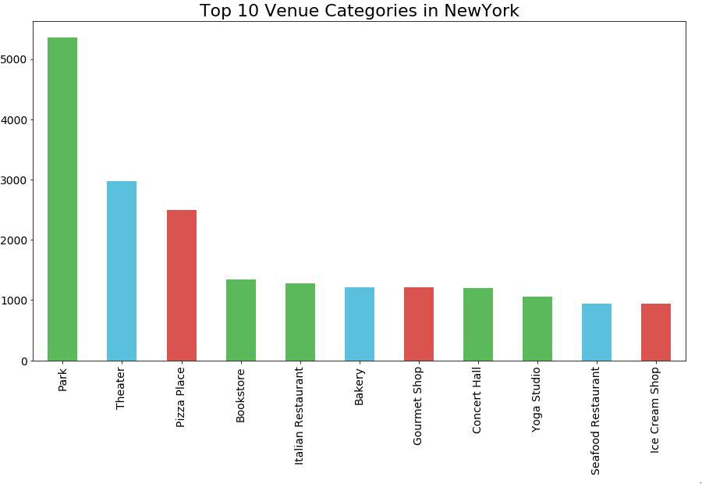
New York data
Top Venue Categories in New York, USA.
There are 5363 Parks in New York making it the greenest city in the 4 cities analysed

Slide 3
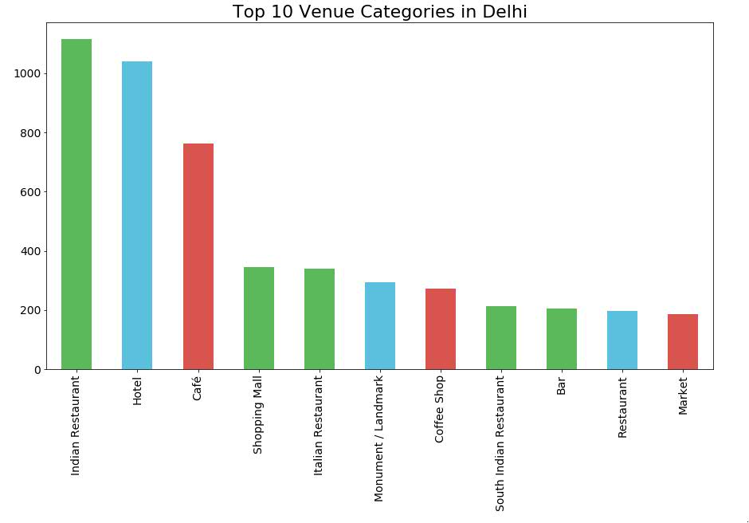
Delhi data
Top Venue Categories in Delhi, India
First 3 entries are Food places in Delhi. Most of the venues are Food related, Restaurants, Café’, Hotel.
Landmark/Monument are part of the Top 10 categories as Delhi is considered to be an Ancient place

Slide 4
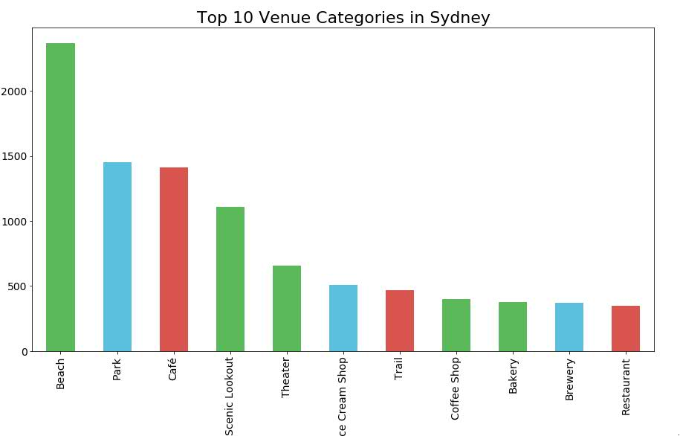
Sydney data
Top Venue Categories in Sydney, Australia
There are more recreational places in Sydney with a lot of Beaches and Parks
Café take the third place.

Slide 5
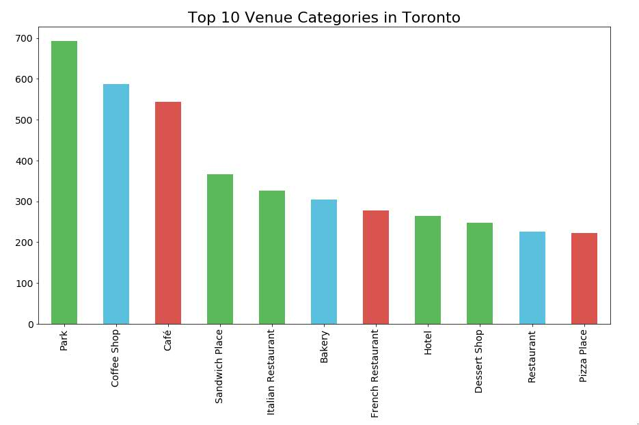
Toronto data
Top Venue Categories in Toronto, Canada
Parks take the first place just as in NewYork. Which is a similarity between the cities.
Coffee Shops take 2nd and 3rd place.
Food places are major part of the city.

Slide 6
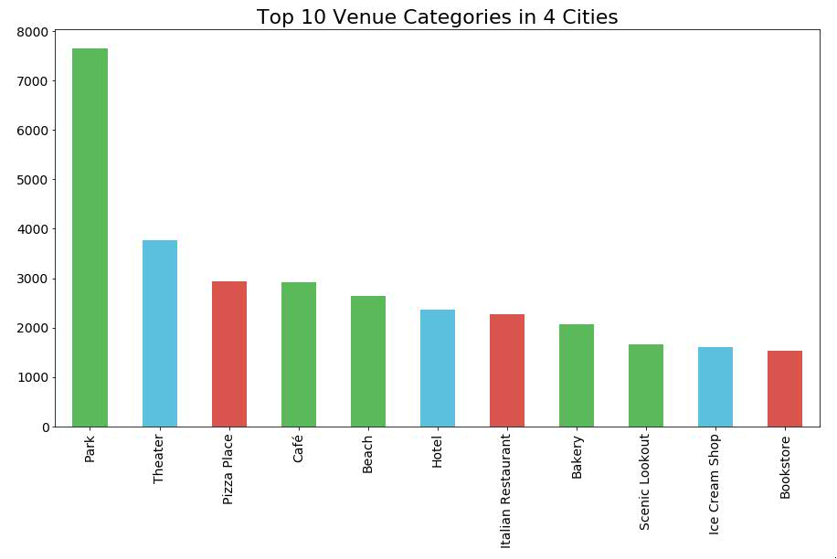
4 Cities data
Top Venue Categories in 4 Major cities.
Parks take the first place
Theaters take 2nd and Pizza places are in 3rd place.
Food places are major part of the cities.

